Slide 1
Chapter Eight
The Internet

Slide 2
What is the Internet?
It is a "network of networks”
Up until the early 1990s, the Internet was largely populated by academic, government, and industrial researchers
the WWW (World Wide Web) changed all that and brought millions of new, non-academic users to the net
Uses TCP/IP protocols and packet switching

Slide 3
How the Internet Works?
the major backbone operators, companies like AT&T and Sprint, operate large international backbone networks, with thousands of routers connected by high-bandwidth fiber optics
Large corporations and hosting services that run server farms connect directly to the backbone
To allow packets to hop between backbones, all the major backbones connect at the NAPs (Network Access Points)
NAP is a room full of routers, at least one per backbone
A LAN in the room connects all the routers
The two core protocols are TCP, the Transmission Control Protocol and IP, the Internet Protocol

Slide 4
IP versions and Addressing
Each TCP/IP host is identified by a logical IP address
A unique IP address is required for each host and network component that communicates using TCP/IP
Each IP address includes a network ID and a host ID
We have two versions of IP, IPv4 and IPv6
IPv4 address is 32 bits long,
IPv6 address is 128 bits long
IPv4 (simply IP from now on) address consists of 32 bits of information
These bits are divided into four sections, referred to as octets or bytes
You can depict an IP address using one of three methods:
Dotted-decimal, as in 172.16.30.56
Binary, as in 10101100.00010000.00011110.00111000
Hexadecimal, as in 82 39 1E 38

Slide 5
Classifying IP Addresses
There are five different address classes: A, B, C, D, and E.
The first three classes A through C, each use a different size for the network ID and host ID portion of the address
Class D is for special type of address called a Multicast Address
Class E is an experimental address class that isn’t used.
The 32-bit IP address is a structured or hierarchical address
In this scheme, a part of the address is designated as the network address, and the other part is designated as either the subnet and host or just the node address
The first four bits of the IP address are used to determine into which class a particular address fits

Slide 6
If the first bit is a zero (0), the address is Class A address.
If the first two bits are 10, the address is a Class B address.
If the first three bits are 110, the address is a Class C address.
If the first four bits are 1110, the address is a Class D address.
If the first four bits are 1111, the address is a Class E address
Class A Addresses
the first octet is the network ID, and the remaining three octets are the host ID
only 126 Class A networks can exist in the entire Internet
each Class A network can accommodate more than 16 million hosts
Only about 40 Class A addresses are actually assigned to companies or organizations
The rest are
either reserved for use by IANA (Internet Assigned Numbers Authority) or
are assigned to organizations that manage IP assignments for geographic regions such as Europe, Asia, and Latin America

Slide 7
Class B addresses
the first two octets of the IP address are used as the network ID, and the second two octets are used as the host ID
a total of 16, 384 Class B network can exist
Each Class B address can accommodate more than 65,000 hosts
Problem: careless assignment of Class B addresses can lead to a large percentage of the available host addresses being wasted on organizations that don’t need them
Class C addresses
the first three octets are used for network ID, and the fourth octet is used for the host ID
each Class C network can accommodate only 254 hosts
allow for more than 2 million networks
Problem: networks are too small

Slide 8
The following table summarizes the details of each address class
Class | Address Number Range | Starting Bits | Length of Network ID | Number of Networks | Host
A | 1 – 126.x.y.z | 0 | 8 | 126 | 16,777,214
B | 128 – 191.x.y.z | 10 | 16 | 16, 384 | 65,534
C | 192 – 223.x.y.z | 110 | 24 | 2,097,152 | 254

Slide 9
Reserved addresses
some blocks of IPv4 addresses have a special usage
These include :
0.0.0.0/8, which is reserved for self-identiﬁcation.
A common address in this block is 0.0.0.0, which is sometimes used when a host boots and does not yet know its IPv4 address.
127.0.0.0/8, which is reserved for loopback addresses.
Each host implementing IPv4 must have a loopback interface (that is not attached to a datalink layer).
By convention, IPv4 address 127.0.0.1 is assigned to this interface.
This allows processes running on a host to use TCP/IP to contact other processes running on the same host.
This can be very useful for testing purposes.

Slide 10
169.254.0.0/16 is used for link-local addresses
Some hosts use an address in this block when they are connected to a network that does not allocate addresses as expected.
10.0.0.0/8, 172.16.0.0/12 and 192.168.0.0/16
are reserved for private networks that are not directly attached to the Internet.
These addresses are often called private addresses

Slide 11
10.0.0.0/8
is a class A network ID
allows the following range of valid IP addresses: 10.0.0.1 to 10.255.255.254
has 24 host bits that can be used for any subnetting scheme within the private organization
172.16.0.0/12
interpreted either
as a block of 16 class B network IDs or
as a 20-bit assignable address space (20 host bits) which can be used for any subnetting scheme within the private organization.
allows the following range of valid IP addresses: 172.16.0.1 to 172.31.255.254.

Slide 12
192.168.0.0/16
interpreted
either as a block of 256 class C network IDs
or as a 16-bit assignable address space (16 host bits), which can be used for any subnetting scheme within the private organization
allows the following range of valid IP addresses: 192.168.0.1 to 192.168.255.254
Traffic to destination private addresses are not reachable on the Internet.
Internet traffic from a host that has a private address must
either send its requests to an application layer gateway (such as a proxy server), which has a valid public address,
or have its private address translated into a valid public address by a network address translator (NAT) before it is sent on the Internet

Slide 13
Subnets and Subnet Masks
Subnetting is the process of creating networks that aren’t limited to the scales provided by Class A, B, C IP addresses
Subnetting is used to create smaller broadcast domains and to better utilize the bits in the host ID.
With subnetting, you can create networks with more realistic host limits
Subnetting provides a more flexible way to designate which portion of an IP address represents the network ID and which portion represents the host ID.
Subnetting lets you select an arbitrary number of bits to use for the network ID

Slide 14
Two reasons compel people to use subnetting
to allocate the limited IP address space more efficiently
performance reasons – networks are segmented into smaller broadcast domains
A subnet is a network that falls within a Class A, B, or C network
Subnets are created by using one or more of the Class A, B, or C host bits to extend the network ID
subnets can have network IDs of any length
The router is aware of the separate subnetted network IDs and will route IP packets to the appropriate subne

Slide 15

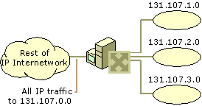
Network 131.107.0.0 before subnetting
Network 131.107.0.0 after subnetting

Slide 16
Subnet Masks
A 32-bit number which is used to inform the router which portion of the host ID should be used for the subnet network ID
The bits of the subnet mask are defined as:
All bits that correspond to the network ID are set to 1.
All bits that correspond to the host ID are set to 0
Each host on a TCP/IP network requires a subnet mask even on a single-segment network
A default subnet mask is based on the IP address classes
the default subnet masks are
Class A – 255.0.0.0
Class B – 255.255.0.0
Class C – 255.255.255.0

Slide 17
To determine the network ID of an IP address, the router must have both the IP address and the subnet mask.
The router then performs a bitwise operation called a Logical AND on the IP address in order to extract the network ID
For example, here’s how the network address is extracted from an IP address using the 20-bit subnet mask from the previous example:
144 28 16 17
IP address: 10010000 00011100 00100000 00001001
Subnet mask: 11111111 11111111 11110000 00000000
Network ID: 10010000 00011100 00100000 00000000
144 28 16 0
Thus, the network ID for this subnet is 144.28.16.0
Network Prefix is a shorthand notation that is used to indicate how many bits of an IP address represent the network ID
The network prefix is indicated with a slash immediately after the IP address, followed by the number of network ID bits to use
For example, the IP address 144.28.16.17 with the subnet mask 255.255.240.0 can be represented as 144.28.16.17/20

Slide 18
Network prefix notation is also called Classless Inter-Domain Routing notation, or just CIDR for short
The table lists the default subnet masks using the network prefix notation for the subnet mask
Since all hosts on the same network must be using the same network ID, the ID must be defined by the same subnet mask
For example, 157.55.0.0/16 is not the same network ID as 157.55.0.0/24. The network ID 157.55.0.0/16 implies a range of valid host IP addresses from 157.55.0.1 to 157.55.255.254. The network ID 157.55.0.0/24 implies a range of valid host IP addresses from 157.55.0.1 to 157.55.0.254.
Address Class | Bits for Subnet Mask | Network Prefix
Class A | 11111111 00000000 00000000 00000000 | /8
Class B | 11111111 11111111 00000000 00000000 | /16
Class C | 11111111 11111111 11111111 00000000 | /24

Slide 19
A few additional restrictions that are placed on subnet masks are:
The minimum number of network ID bits is eight.
The maximum number of network ID bits is 30.
Because the network ID is always composed of consecutive bits set to 1, only nine values are possible for each octet of a subnet mask (including 0).

Slide 20
Subnetting Example
Suppose we are using 255.255.240.0 as a subnet mask and 172.16.0.0 as a Network address (172.16.0.0/20)
answer five simple questions:
How many subnets does the subnet mask produce?
How many valid hosts per subnet?
What are the valid subnets?
What are the valid hosts in each subnet?
What is the broadcast address of each subnet?
How many subnets?
2^{x} – 2 , where X is the amount of masked bits, or the 1s
In this example, . there are 2⁴–2 = 14 subnets

Slide 21
How many hosts per subnet?
2^{x} – 2, where X is the amount of unmasked bits, or the 0s
In this example, there are 2¹² – 2 = 4094 hosts per subnet
What are the valid subnets?
256 – subnet mask = base number.
For example, 256 – 240 = 16, 32, 48, … 224
What are the valid hosts?
Valid hosts are the numbers between the subnets, minus all 0s and all 1s
What is the broadcast address for each subnet?
Broadcast address is all host bits turned on, which is the number immediately after the last host number.
Valid subnet | First Valid host | Last Valid host | Broadcast
16 | 16.1 | 31.254 | 31.255
32 | 32.1 | 47.254 | 47.255

Slide 22
Public and Private Addresses
there are two types of addresses employed on the Internet, public addresses and private addresses
Public Addresses
Public addresses are assigned by InterNIC (Internet Network Information Center)
consist of class-based network IDs or blocks of CIDR-based addresses (called CIDR blocks) that are guaranteed to be globally unique to the Internet
Private Address
An IP address in the private address space is never assigned as a public address
IP addresses within the private address space are known as private addresses

Slide 23
IP Version 6 (IPv6)
is the successor of IP version 4
All IPv6 addresses are 128 bits wide.
This implies that there are 340, 282, 366, 920, 938, 463, 463, 374, 607, 431, 768, 211, 456(3.4 × 10³⁸) different IPv6 addresses.
As the surface of the Earth is about 510,072,000 𝑘𝑚², this implies that there are about 6.67 × 10 IPv6 addresses per square meter on Earth.
Compared to IPv4, which offers only 8 addresses per square kilometer,
IPv6 supports unicast, multicast and anycast addresses.
As with IPv4, an IPv6 unicast address is used to identify one datalink-layer interface on a host.
If a host has several datalink layer interfaces (e.g. an Ethernet interface and a WiFi interface), then it needs several IPv6 addresses.

Slide 24
An IPv6 unicast address is composed of three parts :
A global routing preﬁx that is assigned to the Internet Service Provider that owns this block of addresses
A subnet identiﬁer that identiﬁes a customer of the ISP
An interface identiﬁer that identiﬁes a particular interface on an end-system
interface identiﬁers are always 64 bits wide.
This implies that while there are 2¹²⁸ different IPv6 addresses, they must be grouped in 2⁶⁴ subnets.
The preferred format for writing IPv6 addresses is x:x:x:x:x:x:x:x,
where the x ‘s are hexadecimal digits representing the eight 16-bit parts of the address.

Slide 25
Examples of IPv6 addresses :
abcd:ef01:2345:6789:abcd:ef01:2345:6789
2001:db8:0:0:8:800:200c:417a
fe80:0:0:0:219:e3ff:fed7:1204
IPv6 addresses often contain a long sequence of bits set to 0.
In this case, a compact notation has been deﬁned.
:: is used to indicate one or more groups of 16 bits blocks containing only bits set to 0.
For example,
2001:db8:0:0:8:800:200c:417a is represented as 2001:db8::8:800:200c:417a
ff01:0:0:0:0:0:0:101 is represented as ff01::101
0:0:0:0:0:0:0:1 is represented as ::1
0:0:0:0:0:0:0:0 is represented as ::

Slide 26
An IPv6 preﬁx can be represented as address/length, where length is the length of the preﬁx in bits.
For example, the three notations below correspond to the same IPv6 preﬁx :
2001:0db8:0000:cd30:0000:0000:0000:0000/60
2001:0db8::cd30:0:0:0:0/60
2001:0db8:0:cd30::/60

Slide 27
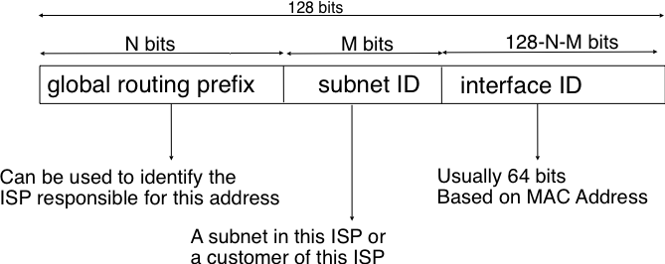
In general, an IPv6 unicast address is structured as shown in the ﬁgure below.

Slide 28
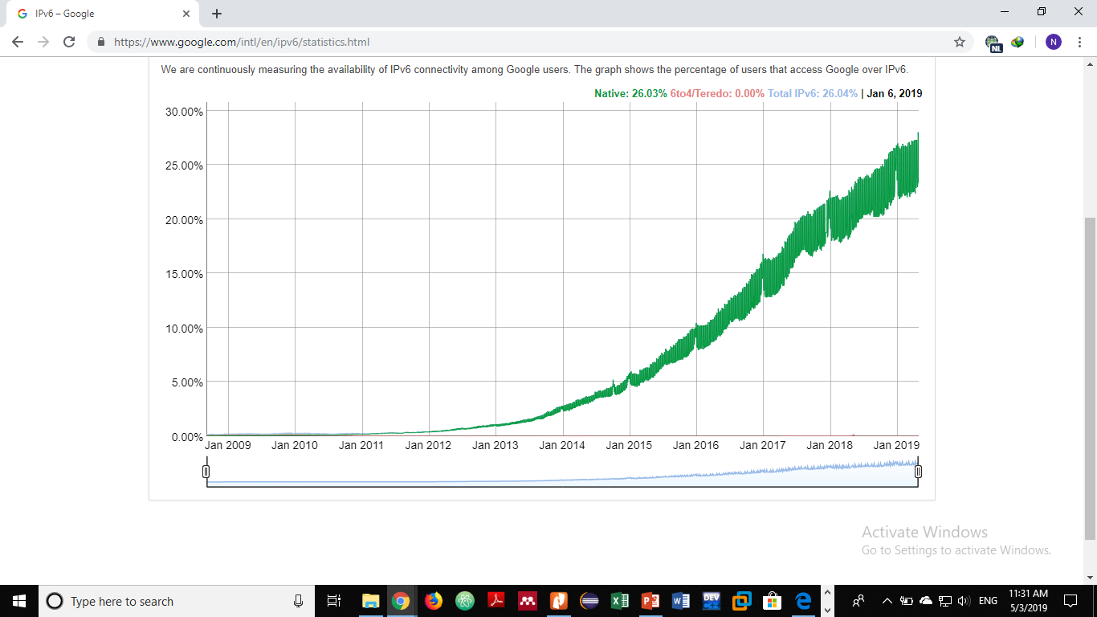
IPv6 Adoption

Slide 29
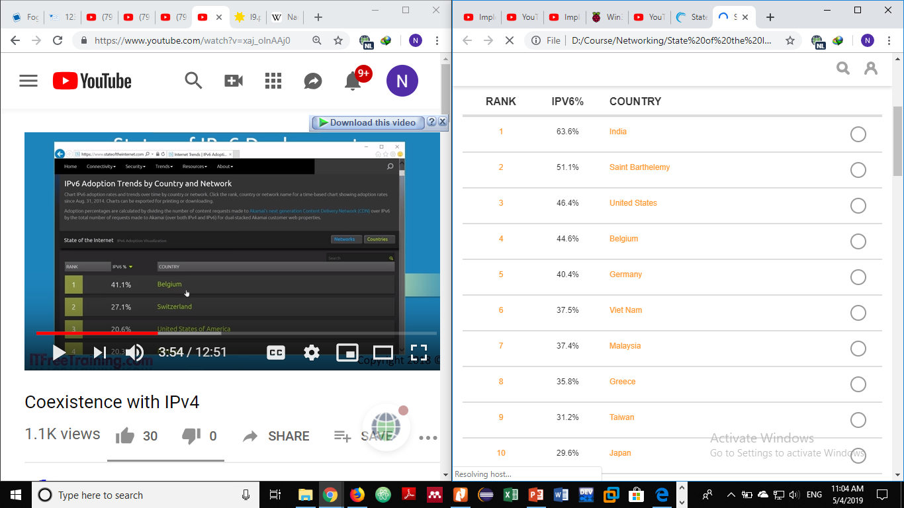
IPv6 Adoption By Country (The top 10 countries)

Slide 30
IPv6 Subnetting Example:
An address provided by the ISP: 2001:db8:cad:: /48
The next 16-bits are available for the subnet.
Consider we are going to create 3 first level subnets:
We require 2 bits as 2 to the power of 2 gives a total of 4 networks.
This leaves 14 bits unallocated
Change the prefix length: /50
The first subnet is 2001:db8:cad:0000:: /50
To identify the increment value:
216 - no. of bits used for the subnet which is 2¹⁶⁻² = 2¹⁴ = 16384 = 0x4000
The next three subnets are
2001:db8:cad:4000:: /50
2001:db8:cad:8000:: /50
2001:db8:cad:c000:: /50

Slide 31
Consider we are going to create 60 second level subnets:
We require 6 bits which generates 64 subnets as 2⁶ = 64
The increment value will be 2¹⁶ ⁻ ⁸ = 2⁸ = 256 = 0x100
Take the second first level subnet address and create the subnets
The prefix length will be changed to /56
The subnets will be:
2001:db8:cad:4000:: /56
2001:db8:cad:4100:: /56
2001:db8:cad:4200:: /56
…
2001:db8:cad:7f00:: /56

Slide 32
Consider we are going to create 10 third level subnets:
We require 4 bits which generates 16 subnets as 2⁴ = 16
Lets take the 2nd second level subnet address and create the subnets
The prefix length will be changed to /60
The increment value will be 2¹⁶ ⁻ ¹² = 2⁴ = 16 = 0x10
Hence, the subnet addresses will be:
2001:db8:cad:4100:: /60
2001:db8:cad:4110:: /60
2001:db8:cad:4120:: /60
…
2001:db8:cad:41f0:: /60

Slide 33
Some Network Services
Directory Service
is simply the software system that stores, organizes and provides access to information in a directory
is a shared information infrastructure for locating, managing, administering, and organizing common items and network resources
is an important component of a NOS
Some of the examples of a directory service are:
LDAP (lightweight Directory Access Protocol) id a directory service in Unix operating system.
Active Directory: a directory service in Windows 2000 Server and later versions

Slide 34
Name Service
maps the names of network resources to their respective network addresses
DNS and WINS (Windows Internet Name Service) is two examples of name services
Domain Name System (DNS)
is a hierarchical distributed database and an associated set of protocols that define
A mechanism for querying and updating the database
A mechanism for replicating the information in the database among servers
A schema of the database
contains various types of data including host names and domain names
The names in a DNS database form a hierarchical tree structure called the domain name space

Slide 35
Domain names consist of individual labels separated by dots. For example: mydomain.microsoft.com
A Fully Qualified Domain Name (FQDN)
is the complete domain name for a specific computer, or host, on the Internet
consists of two parts: the hostname and the domain name.
For example, an FQDN for a hypothetical mail server might be mymail.somecollege.edu. The hostname is mymail, and the host is located within the domain somecollege.edu.
Dynamic Host Configuration Protocol (DHCP)
an open, industry standard, frees network administrators from having to configure all of the computers manually
assigns an IP address to a machine from the pool of available IP addresses

Slide 36
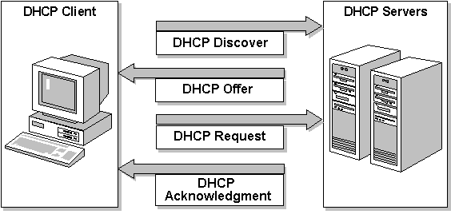
The four steps to assign an IP address dynamically
The DHCP client asks for an IP address (DHCP Discover)
The DHCP server offers an address (DHCP Offer)
accepts the offer and requests the address (DHCP Request)
officially assigned the address (DHCP Acknowledge)
the DHCP server places an administrator-defined time limit on the address assignment, called a lease

